Slide 1
Project on management Accounting
By
Shashank Gubba (SID: 110288232)

Slide 2
contents
Abstract
Introduction
Problem Statement
Summary of Production
Solving with Excel Solver
Solving with Python Gurobi
Results

Slide 3
Abstract
Management accounting is an important factor for any organization in order to maximize their profits at a regular amount of revenue, labor, raw materials, time etc. In this project we can see two different methods of optimization, which is used to obtain maximum profits for a company that manufactures washing machines by using minimum number of resources.

Slide 4
INtroduction
Beacon Co. is a manufacturer of washing machines. It currently sells two models of washing machines: the Arkel and the Kallex. At the start of every production cycle, Beacon must decide how many units of each washing machine to produce, given its available resources. In the coming production cycle, Beacon faces key resource constraints. In particular, it has only 3,132 hours of labor, 1,440 feet of rubber hosing, and 200 drums available.

Slide 5
Problem statement
Selling each Arkel unit earns the company a profit of $350 while selling each Kallex unit earns the company a profit of $300. At the same time, manufacturing each Arkel unit requires 18 hours of labour, 6 feet of rubber hosing, and 1 drum, while manufacturing each Kallex unit requires 12 hours of labour, 8 feet of rubber hosing, and 1 drum. Details of the relevant facts are summarized in the table "Summary of Production of Washing Machines". Based on these facts and the assumption that 100% of production will be sold, Beacon must decide how many units of each washing machine to produce in the coming production run to maximize profits.

Slide 6
Summary of production
 | Arkel | Kallex | Total Available
Labor Hours | 18 hours per unit | 12 hours per unit | 3132 hours
Rubber hosing | 6 feet per unit | 8 feet per unit | 1440 feet
Drums | 1 per unit | 1 per unit | 200 drums
Profits | $350 per unit | $300 per unit

Slide 7
Solving with excel solver
To solve using the Excel Solver we must know objective function, decision variables and constraints.
In this project as per the given data following are the factors:
Objective Function is Total maximized profit, which is given by the product of production quantity and unit profits.
Decision variables are the quantity of each model of washing machines to be produced.
Constraints are drums required, labor required, and rubber hosing required.

Slide 8
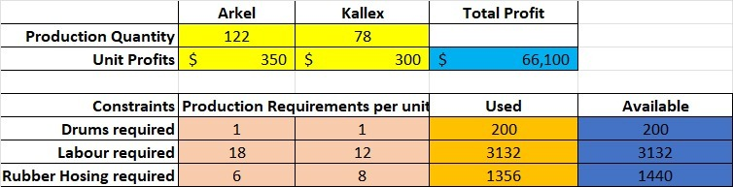
Solving with excel solver

Slide 9
Formulas and constraints used in excel solver
Formulas:
Total Profit, “=SUMPRODUCT(C4:D4,C3:D3)”
Drums used, “=SUMPRODUCT(C7:D7,C3:D3)”
Labor used, “=SUMPRODUCT(C8:D8,C3:D3)”
Rubber hosing used, “=SUMPRODUCT(C9:D9,C3:D3)”
Constraints:
Used resources <= Available resources, “E7:E9<=F7:F9”
Decision Variables:
No. of units of each type of washing machines produced, “C3:D3”

Slide 10
Solving with python gurobi
In Python, we use Gurobi package to solve the problem.
All the factors like objective function, decision variables, constraints remain the same for Python Gurobi as well.
Initially we need to import the Gurobi package and then should proceed to solve the problem in Python.

Slide 11
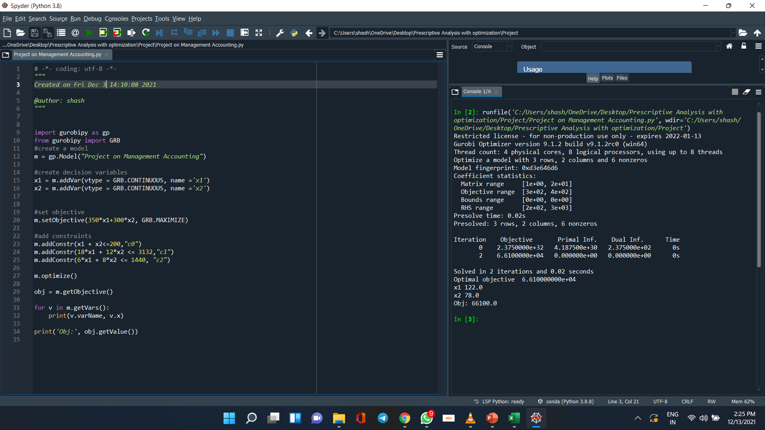
Solving with python gurobi
Following is the code that I have used to optimize the problem using Python Gurobi

Slide 12
Solving using python gurobi
Results obtained from Python Gurobi.

Slide 13
Results
Following are the result obtained using both Excel Solver and Python Gurobi:
No. of Arkel units to be manufactured: 122 units.
No. of Kallex units to be manufactured: 78 units.
Maximum profit that can be obtained with the constraints is $66,100.

Slide 14
THANK YOU!

